Slide 1

27 June 2025
Real-time Wireless Telemetry System for a Formula Student Electric Vehicle
Coordinator
Student
ART TU Cluj-Napoca
Conf. Dr. Eng. Bogdan Iancu
Tompea Radu-Gabriel

Slide 2
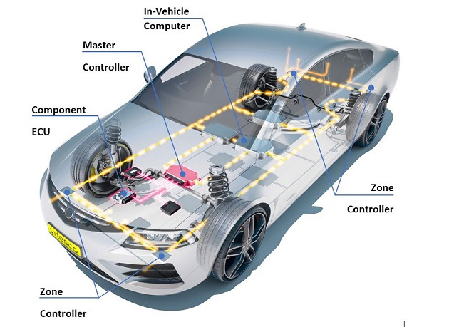
Introduction
27 June 2025
Telemetry systems play a crucial role in modern automobiles, allowing engineers to monitor and react to sensor data from a vehicle in real time, providing data about battery state, motor temperature and much more.
This project proposes a low-cost, real-time wireless telemetry system that helps engineers receive vital information without needing to be in or near the car.
Figure 1: Electric vehicle Architecture
1
2

Slide 3
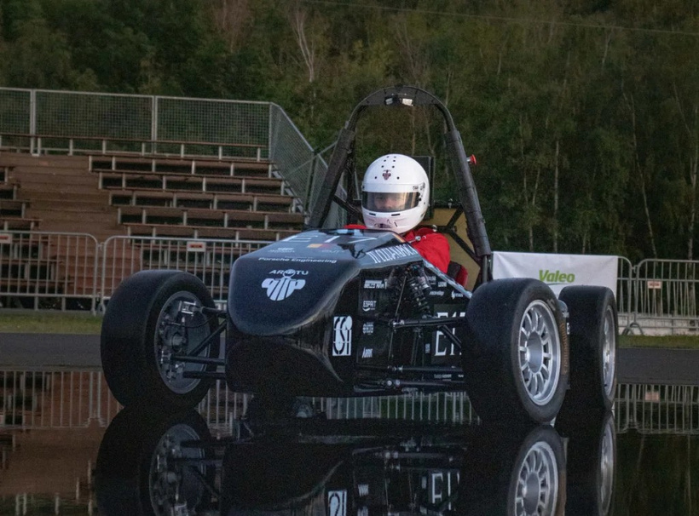
About Formula Student
27 June 2025
Formula Student is a global competition that challenges university teams to design, build, and race small single-seater cars. It aims to develop a students ability to innovate and solve problems in a fast paced environment.
The ART TU Cluj-Napoca team from the Technical University of Cluj-Napoca, entered this competition with their E17 electric vehicle in 2019, and over the years, competing in Czechia, Romania and Germany in 2025.
2
2
Figure 2: ART TU E17 Electric Vehicle

Slide 4
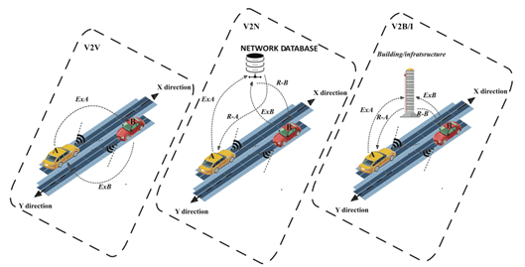
Current status of Telemetry Systems
27 June 2025
Vehicle-to-Everything (V2X) is a generic term that refers to a wireless communication system that allows the exchange of data in real time between a vehicle and any entity in its environment, including other vehicles (V2V), infrastructure (V2I) and communication networks (V2N). The main purpose of this technology is to improve safety on the road and reduce traffic.
Multiple variations of this technology exist, most notably Vehicle-To-Vehicle (V2V), Vehicle-To-Network (V2N), and Vehicle-To-Building (V2B)
3
Fig 3: Different working principles for V2V, V2N, V2B/I
2

Slide 5
State of the Art
27 June 2025
IoT-based Telemetry
Real-time video and GPS
Vehicle Diagnosis with V2N
Advantages:
Accurate Location
Long transmission times
Disadvantages:
Data processing delays
Unreliable connectivity
Hard to install
High variability with data formats
Advantages:
Innovative technology use
Accurate Location
Disadvantages:
Short Distances
High volume of data
High coupling of the system
High use of bandwidth
Advantages:
High security
Roboust system
Disadvantages:
Data processing delays
Data is not accurate
Complicated infrastucture needed
4
2

Slide 6
Proposed solution
Pros and cons
27 June 2025
Advantages:
Uses Long Range Radio to achieve long distances.
Standard automotive communication protocols, resistant to noise and interference.
Programming paradigms guarantee high refresh rate.
Plug-and-play design, easy maintanance.
Reduced cost due to not depending on infrastructures like The Things Network.
Disadvantages:
Small packet size due to Radio limitation.
Low Duty Cycle due to Radio regulations.
Algorithms used to achieve long distances are unreliable for distances greater than 1km.
5
2

Slide 7
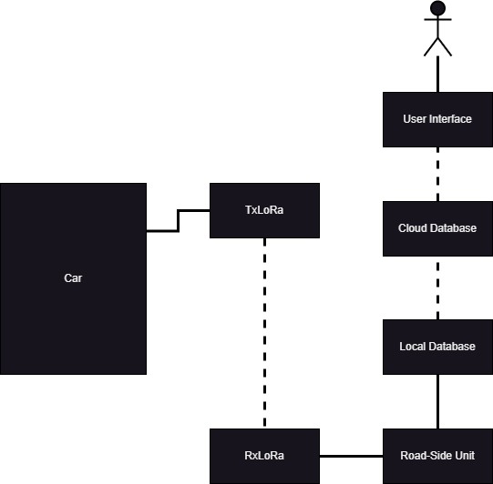
Proposed solution
Conceptual Architecture
27 June 2025
Figure 4: Conceptual Architecture of ART TU E17's telemetry system
6
2

Slide 8






Technology Stack
27 June 2025
7
2

Slide 9
Proposed solution
Tehniques
27 June 2025
Frequency hopping is used for transmitting a large volume of data in real-time using LoRa, using 7 frequencies, allowing my solution to bypass regulations.
ISO 15765-2 or ISO-TP is a which allows the sending of data from the ECU to the transmitter in one single message, permitting more data to be sent.
Fog computing is critical for this system, increasing the refresh rate of the display greatly and providing an extra level of redundancy.
8
2

Slide 10
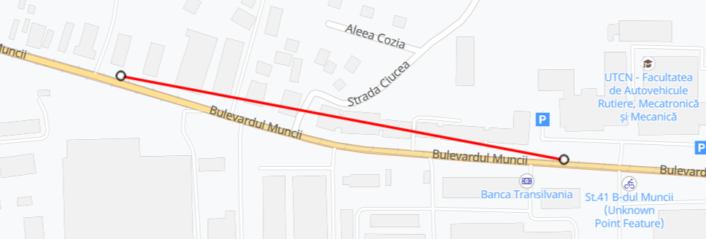
Proposed solution
Testing
27 June 2025
Initially, the system was tested using 2 laptops, one as the transmitter and one as the receiver.
The goal was to get as much distance between the transmitter and the receiver without compromising the integrity of the data.
Achieved a distance of 400 meters, shown below.
9
2
Fig 5: Calculated distance while testing

Slide 11
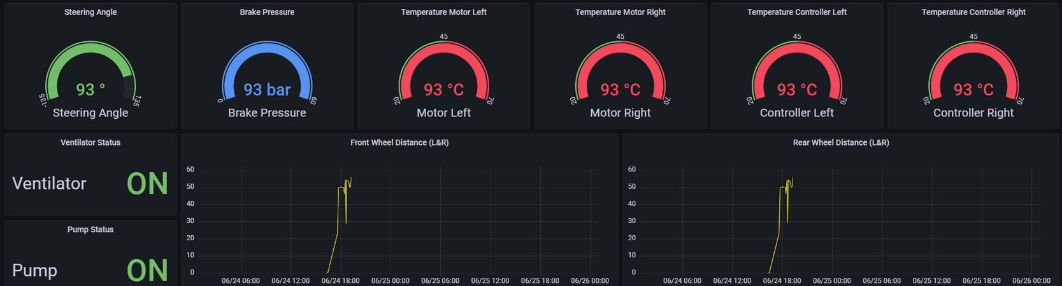
Results
27 June 2025
From testing, the system managed to get a response time of 1s without compromising the data at 400m distance.
It proved massively useful to the development team, using it to spot problems while the electric car was in motion.
Below is pictured a mock-up of the User Interface.
10
2
Fig 6: User Interface Mock-up

Slide 12
Conclusions
27 June 2025
To conclude, this project presents a powerful but low-cost solution for real-time telemetry in a Formula Student electric race car.
It solves key problems like latency, encryption, modularity, and cost, while
remaining easy to deploy and maintain.
Future work includes integrating the system with the ECU, field testing during dynamic events, and refining the web-based dashboard for improved usability and real-time performance analysis.
11
2

Slide 13
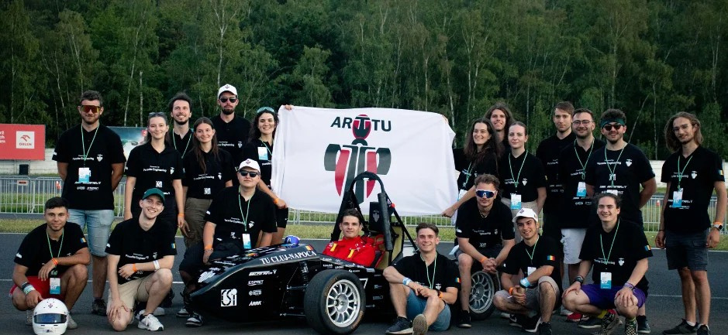
Thank you for your attention!
Figura 7: ART TU team 2023-2024

